Slide 1

Covid 19 project
By Akshada parbhane

Slide 2
Problems statement
which country has highest cumulative total?
Which region present highly total and death cases?
In difference difference between cumulative total and death cases?
difference between cumulative total and death cases?
As per these cases which frequence is highest?

Slide 3
show which region has highest cumulative cases?
As per following chart we can see that Europe region has highest cumulative cases compare to others

Slide 4
which country has highest cumulative total?
As per following state united states of America has highest cumulative total

Slide 5
Which region present highly total and death cases?
As per following bar graph Americas region has highest cumulative total in other side death cases are equal for all region

Slide 6
In highest between cumulative total and death cases?
Compare to Germany , Canada ,Austria and Afghanistan Germany has highest cumulative total then Canada ,as compare to Afghanistan has present few cumulative cases

Slide 7
As per these cases which frequence is heighest?
we can see in column chart highest average is sum of cumulative cases

Slide 8
As per 10000 sum of cumulative total which country has highly present death cases
compare to 10000 population Americas has highest deaths are present

Slide 9
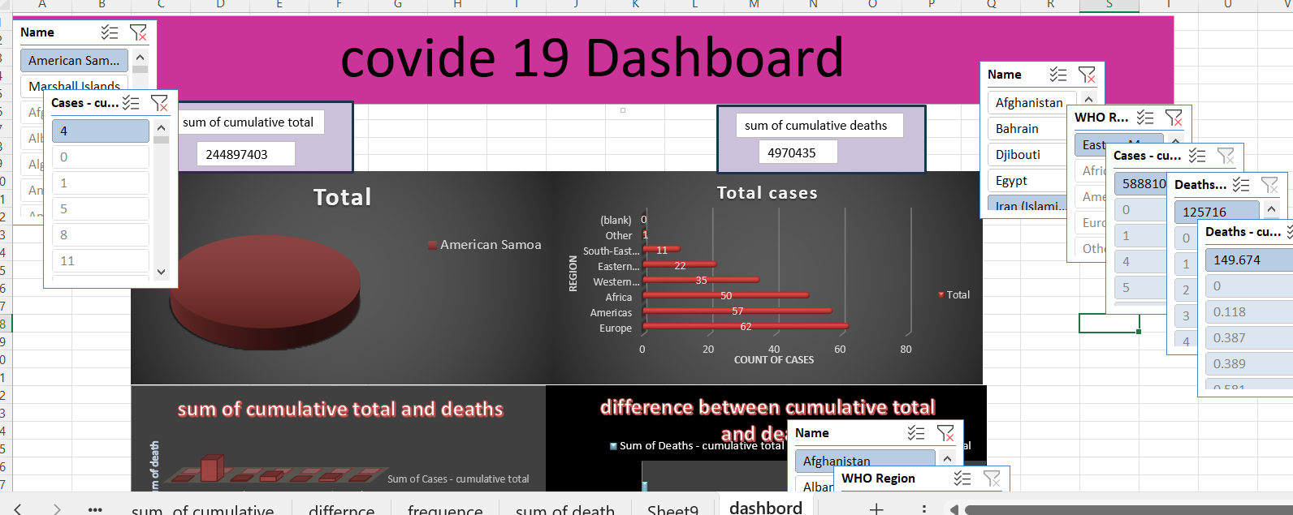
Dashboard

Slide 10
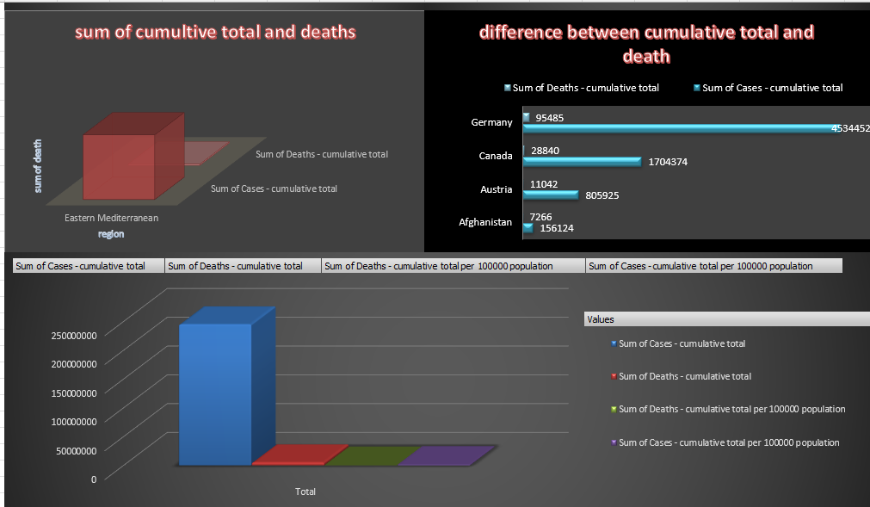
DASHBOARD

Slide 11

HOW TO PROTECT YOURSELF FROM C0RONAVIRUS ?
Don’t spit in public

Slide 13
THANK YOU…….

